Slide 1
From SqueezeNet to SqueezeBERT:
Developing efficient deep neural networks
Forrest Iandola¹, Albert Shaw², Ravi Krishna³, Kurt Keutzer⁴
¹UC Berkeley → DeepScale → Tesla → Independent Researcher
²Georgia Tech → DeepScale → Tesla
³UC Berkeley
⁴UC Berkeley → DeepScale → UC Berkeley

Slide 2
Overview
Part 1: What have we learned from the last 5 years of progress in efficient neural networks for Computer Vision?
Part 2: SqueezeBERT — what can Computer Vision research teach Natural Language Processing research about efficient neural networks?

Slide 3
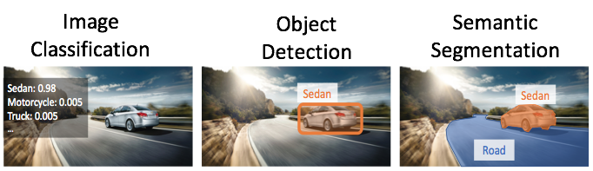
Key tasks in computer vision
(abridged)
Image Classification
Object Detection
Semantic Segmentation
Slide credit: Kurt Keutzer

Slide 4
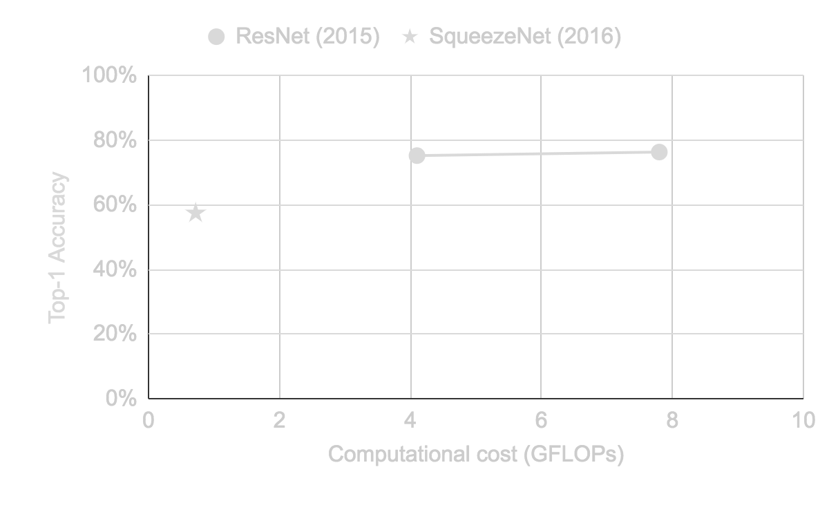
Progress in image classification
Dataset: ImageNet validation set
[1] Kaiming He, Xiangyu Zhang, Shaoqing Ren, Jian Sun. Deep Residual Learning for Image Recognition. arxiv:1512.03385 and CVPR 2016.
[2] Forrest N. Iandola, Song Han, Matthew W. Moskewicz, Khalid Ashraf, William J. Dally, and Kurt Keutzer SqueezeNet: AlexNet-level accuracy with 50x fewer parameters and < 0.5MB model size. arXiv, 2016.
[3] Hugo Touvron, Andrea Vedaldi, Matthijs Douze, Hervé Jégou. Fixing the train-test resolution discrepancy: FixEfficientNet. arXiv:2003.08237, 2020.
Notes:
ResNet-101 to FixEfficientNet-B0: 40x fewer FLOPs

Slide 5
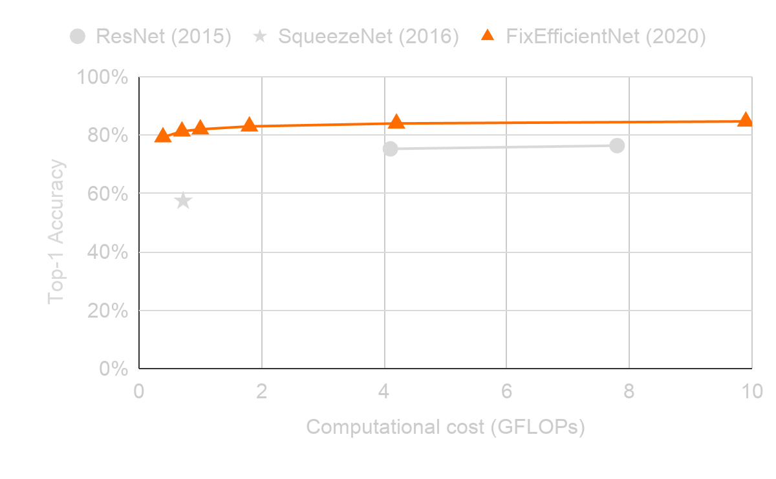
Progress in image classification
Dataset: ImageNet validation set
[1] Kaiming He, Xiangyu Zhang, Shaoqing Ren, Jian Sun. Deep Residual Learning for Image Recognition. arxiv:1512.03385 and CVPR 2016.
[2] Forrest N. Iandola, Song Han, Matthew W. Moskewicz, Khalid Ashraf, William J. Dally, and Kurt Keutzer SqueezeNet: AlexNet-level accuracy with 50x fewer parameters and < 0.5MB model size. arXiv, 2016.
[3] Hugo Touvron, Andrea Vedaldi, Matthijs Douze, Hervé Jégou. Fixing the train-test resolution discrepancy: FixEfficientNet. arXiv:2003.08237, 2020.
Notes:
ResNet-101 to FixEfficientNet-B0: 40x fewer FLOPs

Slide 6
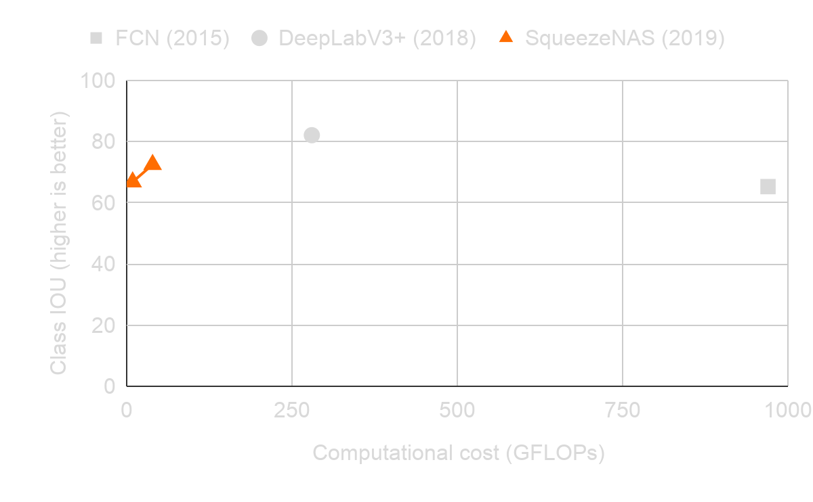
Progress in semantic segmentation
Dataset: Cityscapes test set
[1] Jonathan Long, Evan Shelhamer, Trevor Darrell. Fully Convolutional Networks for Semantic Segmentation. arXiv:1411.4038 and CVPR 2015.
[2] Liang-Chieh Chen, Yukun Zhu, George Papandreou, Florian Schroff, Hartwig Adam. Encoder-Decoder with Atrous Separable Convolution for Semantic Image Segmentation. (DeepLabV3+ paper.) ECCV, 2018.
[3] Albert Shaw, Daniel Hunter, Forrest Iandola, Sammy Sidhu. SqueezeNAS: Fast neural architecture search for faster semantic segmentation. arXiv:1908.01748 and ICCV Workshops, 2019.
Notes:
FCN to SqueezeNAS-LAT-Small: 161x fewer FLOPs

Slide 7
What has enabled these improvements?

Slide 8
What has enabled these improvements? (1/3)
Grouped Convolutions
c_{out}= 8
c_{in}= 8
(a) groups=1
c_{in} = number of input channels
c_{out} = number of output channels
[1] A. Krizhevsky, I. Sutskever, G. E. Hinton, ImageNet Classification with Deep Convolutional Neural Networks. NeurIPS, 2012.

Slide 9
What has enabled these improvements? (1/3)
Grouped Convolutions
c_{out}= 8
c_{out}= 8
c_{out}= 8
c_{in}= 8
c_{in}= 8
c_{in}= 8
(a) groups=1
(b) groups=4
(c) groups=4
with optimized storage
c_{in} = number of input channels
c_{out} = number of output channels
[1] A. Krizhevsky, I. Sutskever, G. E. Hinton, ImageNet Classification with Deep Convolutional Neural Networks. NeurIPS, 2012.

Slide 10
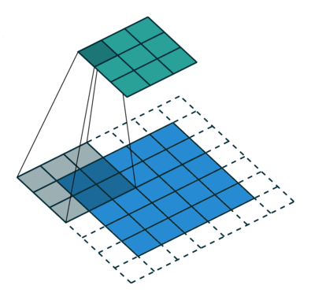
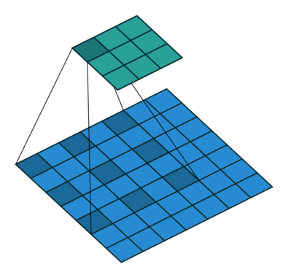
What has enabled these improvements? (2/3)
Dilated Convolutions
Normal 3x3 Convolution
Dilated 3x3 Convolution
Graphic credit: Sik-Ho Tsang, https://towardsdatascience.com/review-dilated-convolution-semantic-segmentation-9d5a5bd768f5

Slide 11
What has enabled these improvements? (3/3)
Supernetwork-based Neural Architecture Search
Possible deep neural network modules
Module 1
Module 2
Module 3
Reinforcement Learning-based NAS [2]
Supernetwork-based NAS [1]
Neural Net 1
Neural Net 2
Neural Net 1000
Module Choice 1
Module Choice 2
Module Choice N
Typical search time:
1000x the cost of a single training run (1000s of GPU days)
Typical search time:
2x to 10x the cost of a single training run (10s of GPU days)
[1] Albert Shaw, Daniel Hunter, Forrest Iandola, Sammy Sidhu. "SqueezeNAS: Fast neural architecture search for faster semantic segmentation." ICCV Neural Architects Workshop, 2019.
[2] Barret Zoph and Quoc V. Le. "Neural architecture search with reinforcement learning." International Conference on Learning Representations, 2017.

Slide 12
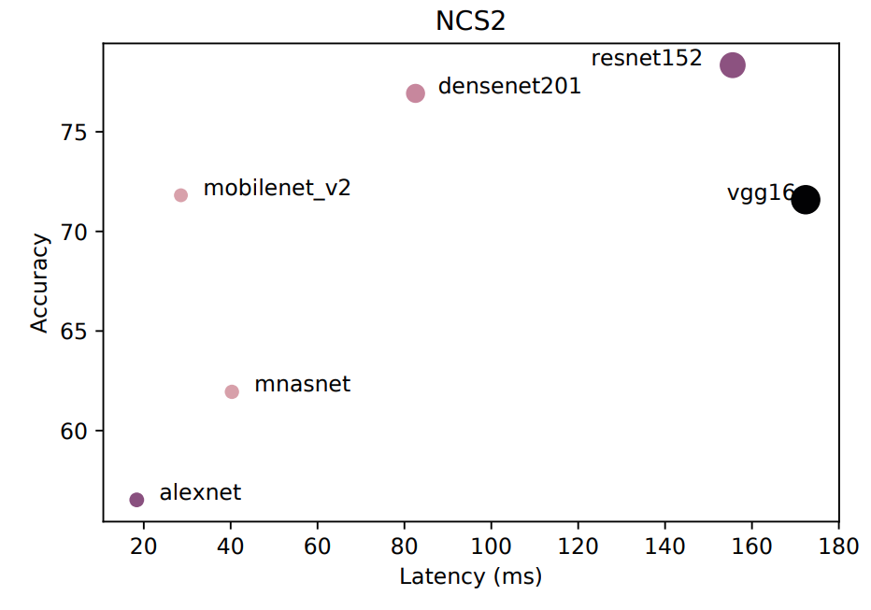
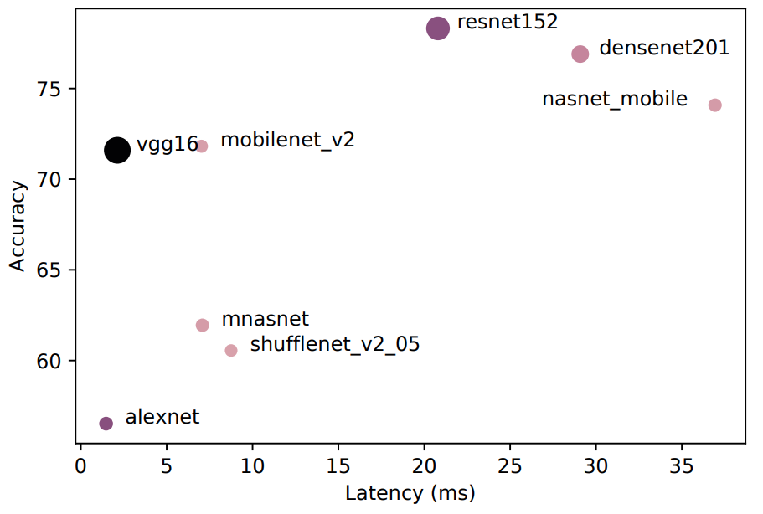
The need for optimizing neural networks for specific hardware
Movidius Neural Compute Stick 2
mobilenet_v2 is 5x faster than vgg16
NVIDIA 2080Ti GPU
mobilenet_v2 is 2x slower than vgg16
for all experiments, batch size = 1
Image credit:
Mario Almeida, Stefanos Laskaridis, Ilias Leontiadis, Stylianos I. Venieris, Nicholas D. Lane. "EmBench: Quantifying Performance Variations of Deep Neural Networks across Modern Commodity Devices." MobiSys, 2019
Notes:
vgg16: 16 GFLOPs/frame
mobilenet_v2: 0.3 GFLOPs/frame

Slide 13
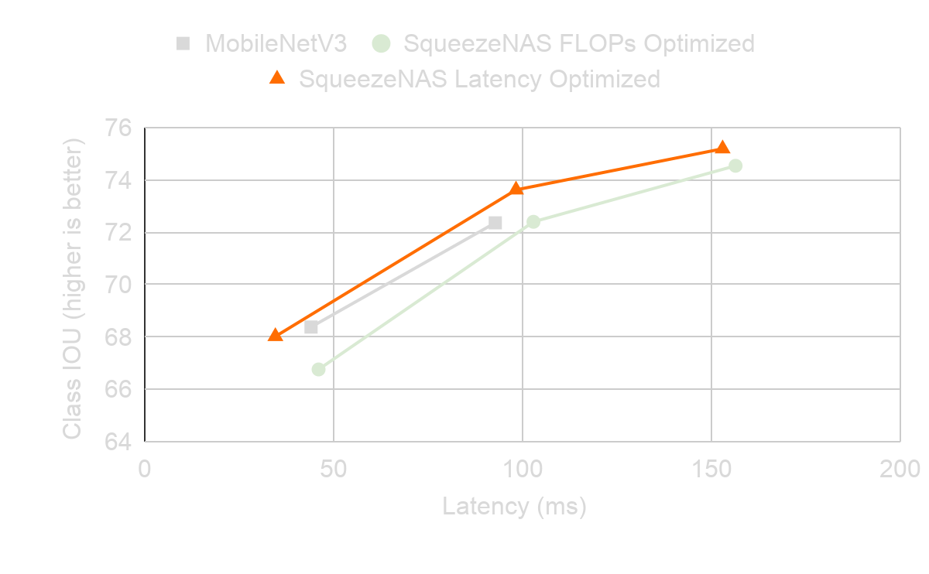
SqueezeNAS: optimizing for accuracy and latency
Dataset: Cityscapes validation set
Target hardware: NVIDIA Xavier mobile GPU (30 Watts)
The SqueezeNAS search space includes grouped convolutions and dilated convolutions
[1] Albert Shaw, Daniel Hunter, Forrest Iandola, Sammy Sidhu. SqueezeNAS: Fast neural architecture search for faster semantic segmentation. arXiv:1908.01748 and ICCV Workshops, 2019.
Notes:
How does the NN change for FLOP vs Latency optimization?
FLOP-optimized: high-res filters (e.g. 5x5) with few channels
Latency-optimized: 3x3 and 3x3 dilated filters with more channels. Downsample earlier in the network.

Slide 14
Summary of Part 1 (computer vision)
2015 → 2020:
40 - 160x reduction in computational cost without changing accuracy
and also...
double-digit improvements in accuracy without increasing computational cost
What were some of the key ingredients in these improvements?
Grouped convolutions
Dilated convolutions
Neural architecture search

Slide 15
Part 2: Efficient Neural Networks for Natural Language Processing
Motivating efficient neural networks for natural language processing
Background on self-attention networks for NLP
SqueezeBERT: Designing efficient self-attention neural networks
Results: SqueezeBERT vs others on a smartphone

Slide 16
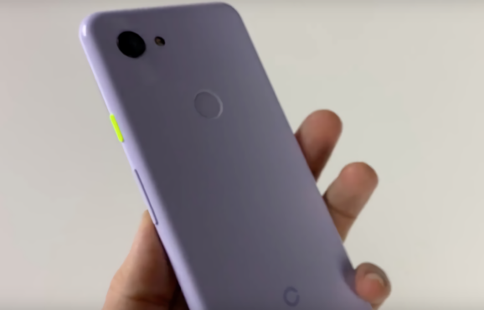




Why develop mobile NLP?
Humans write 300 billion messages per day [1-4]
Over half of emails are read on mobile devices [5]
Nearly half of Facebook users only login on mobile [6]
On-device NLP will help us to read, prioritize, understand and write messages
[1] https://www.dsayce.com/social-media/tweets-day
[2] https://blog.microfocus.com/how-much-data-is-created-on-the-internet-each-day
[3] https://www.cnet.com/news/whatsapp-65-billion-messages-sent-each-day-and-more-than-2-billion-minutes-of-calls
[4] https://info.templafy.com/blog/how-many-emails-are-sent-every-day-top-email-statistics-your-business-needs-to-know
[5] https://lovelymobile.news/mobile-has-largely-displaced-other-channels-for-email
[6] https://www.wordstream.com/blog/ws/2017/11/07/facebook-statistics

Slide 17
Self-attention networks have disrupted NLP
Natural Language Generation (NLG)
NLG Tasks: Machine Translation, Sentence Completion, Generative Question Answering
Self-Attention Models: Transformer [1], Transformer-XL, GPT-2, GPT-3, Turing-NLG
Natural Language Understanding (NLU)
NLU Tasks: Extractive Question Answering, Text Classification
Self-Attention Models: GPT, BERT, ALBERT
Training mechanisms: RoBERTa, ELECTRA
[1] A. Vaswani, N. Shazeer, N. Parmar, J. Uszkoreit, L. Jones, A. N. Gomez, L. Kaiser, and I. Polosukhin, Attention is all you need. NeurIPS, 2017.

Slide 18
How fast is BERT-base on a smartphone?
BERT-base
in PyTorch
TorchScript
Google Pixel 3 Smartphone
BERT Latency: 1.7 seconds per sentence
batch size: 1
sequence length: 128
Is TensorFlow faster than PyTorch?
It has been reported that TensorFlow-Lite runs BERT-base at 1.5 seconds per sentence on a Pixel 3 phone. [1]
[1] Z. Sun, H. Yu, X. Song, R. Liu, Y. Yang, and D. Zhou, “MobileBERT: Task-agnostic compression of BERT by progressive knowledge transfer,” OpenReview submission, 2019.

Slide 19
The BERT Module
Input tensor (W, C)
K layer (FC)
V layer (FC)
Q layer (FC)
Q tensor (W, C)
K tensor (W, C)
V tensor (W, C)
Reshape
Reshape
Reshape
Q tensor
(E, W, C/E)
K tensor
(E, C/E, W)
MatMul
V tensor
(E, W, C/E)
MatMul
QK tensor
(E, W, W)
QKV tensor
(E, W, C/E)
W = sequence length = 128
C = channels = 768
E = number of hEads = 12
Residual connections not shown.

Slide 20
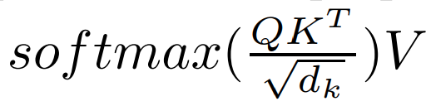
The BERT Module
Input tensor (W, C)
K layer (FC)
V layer (FC)
Q layer (FC)
Q tensor (W, C)
K tensor (W, C)
V tensor (W, C)
Reshape
Reshape
Reshape
Q tensor
(E, W, C/E)
K tensor
(E, C/E, W)
MatMul
V tensor
(E, W, C/E)
Self-Attention:
MatMul
QK tensor
(E, W, W)
QKV tensor
(E, W, C/E)
W = sequence length = 128
C = channels = 768
E = number of hEads = 12
d_{k} = C/E
Residual connections not shown.

Slide 21
The BERT Module
Input tensor (W, C)
K layer (FC)
V layer (FC)
Q layer (FC)
Q tensor (W, C)
K tensor (W, C)
V tensor (W, C)
Reshape
Reshape
Reshape
Q tensor
(E, W, C/E)
K tensor
(E, C/E, W)
MatMul
V tensor
(E, W, C/E)
MatMul
QK tensor
(E, W, W)
QKV tensor
(E, W, C/E)
Reshape
QKV tensor (W, C)
Feed Forward Network Layer 1 (FC)
FFN1 tensor (W, C)
Feed Forward Network Layer 2 (FC)
W = sequence length = 128
C = channels = 768
E = number of hEads = 12
FFN2 tensor (W, 4C)
Feed Forward Network Layer 3 (FC)
Residual connections not shown.
FFN3 tensor (W, C)

Slide 22
The BERT Module
Input tensor (W, C)
K layer (FC)
V layer (FC)
Q layer (FC)
Q tensor (W, C)
K tensor (W, C)
V tensor (W, C)
Reshape
Reshape
Reshape
Q tensor
(E, W, C/E)
K tensor
(E, C/E, W)
MatMul
V tensor
(E, W, C/E)
MatMul
QK tensor
(E, W, W)
QKV tensor
(E, W, C/E)
Reshape
On a Google Pixel 3, 88% of the latency is in the FC layers.
QKV tensor (W, C)
Feed Forward Network Layer 1 (FC)
FFN1 tensor (W, C)
Feed Forward Network Layer 2 (FC)
W = sequence length = 128
C = channels = 768
E = number of hEads = 12
FFN2 tensor (W, 4C)
Feed Forward Network Layer 3 (FC)
Residual connections not shown.
FFN3 tensor (W, C)

Slide 23
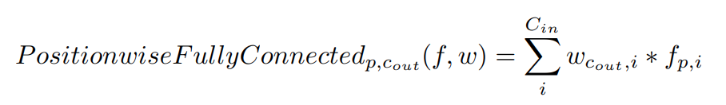
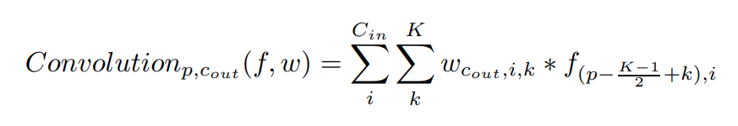
The fully-connected layers in BERT are 1D convolutions
for one output channel c_{out} and one sequence-element p:
f = features
w = weights
Cin = input channels
K= kernel size
Therefore, the positionwise fully-connected layer is equivalent to a 1D convolution with kernel-size 1.
Going forward, we will think of BERT as a convolutional neural network.

Slide 24
The SqueezeBERT Module
Input tensor (C, W)
K layer g=4
V layer g=4
Q layer g=4
Q tensor (C, W)
K tensor (C, W)
V tensor (C, W)
Reshape
Reshape
Reshape
Q tensor
(E, W, C/E)
K tensor
(E, C/E, W)
MatMul
V tensor
(E, W, C/E)
MatMul
QK tensor
(E, W, W)
QKV tensor
(E, W, C/E)
Reshape
QKV tensor (C, W)
Feed Forward Network Layer 1 g=1
FFN1 tensor (C, W)
Feed Forward Network Layer 2 g=4
W = sequence length = 128
C = channels = 768
E = number of hEads = 12
g= number of groups
FFN2 tensor (4C, W)
Feed Forward Network Layer 3 g=4
Residual connections not shown.
FFN3 tensor (C, W)

Slide 25
Evaluation

Slide 26
General Language Understanding Evaluation (GLUE) [1]
GLUE is a benchmark that is primarily focused on text classification.
A neural network's GLUE score is a summary of its accuracy on the following tasks:
GLUE Tasks | What is the input to the neural network? | What does the neural network tell me? | Potential use-case
SST-2 | one sequence | Positive or Negative sentiment | Flag emails and online content from unhappy customers
MRPC, QQP, WNLI, RTE, MNLI, STS-B | two sequences | Does the pair of sequences have a similar meaning? Note: Some of the tasks have subtly different definitions of similarity between sentences. | In the long email that I am writing, am I just saying the same thing over and over? Am I repeating myself a lot?
QNLI | two sequences (a question and answer pair) | Has the question been answered? | On an issue tracker, which issues can I close?
CoLA | one sequence | Is the sequence grammatically correct? | A smart grammar check in Gmail or similar
[1] A. Wang, et al. GLUE: A Multi-Task Benchmark and Analysis Platform for Natural Language Understanding. arXiv:1804.07461, 2018.
Notes:
Definition of textual entailment: https://demo.allennlp.org/textual-entailment

Slide 27
Results
Neural Network Architecture | GLUE score (test set) | GFLOPs per sequence | Latency on Google Pixel 3 (seconds) | Speedup
BERT-base [1] | 78.3 | 22.5 | 1.7 | 1x
MobileBERT [2,3] | 78.5 | 5.36 | 0.57 | 3.0x
SqueezeBERT (ours) [4] | 78.1 | 7.42 | 0.39 | 4.3x
Setting: single-model (no ensemble), PyTorch, sequence-length 128, batch size 1
MobileBERT and SqueezeBERT use distillation from a pretrained BERT-base architecture. There are more details about distillation that you can read in the SqueezeBERT paper.
[1] J. Devlin, M.-W. Chang, K. Lee, K. Toutanova, BERT: Pre-training of deep bidirectional transformers for language understanding. arXiv 2018 and NAACL, 2019
[2] Zhiqing Sun, Hongkun Yu, Xiaodan Song, Renjie Liu, Yiming Yang, Denny Zhou. MobileBERT: Task-Agnostic Compression of BERT by Progressive Knowledge Transfer. OpenReview, 2019.
[3] Zhiqing Sun, Hongkun Yu, Xiaodan Song, Renjie Liu, Yiming Yang, Denny Zhou. MobileBERT: a Compact Task-Agnostic BERT for Resource-Limited Devices. arXiv and ACL, 2020.
[4] Forrest N. Iandola, Albert E. Shaw, Ravi Krishna, Kurt W. Keutzer. SqueezeBERT: What can computer vision teach NLP about efficient neural networks? arXiv, 2020.

Slide 28
Conclusions
Computer vision research has progressed rapidly in the last 5 years. Big gains in accuracy and efficiency.
Self-attention neural networks bring higher accuracy to NLP, but they are very computationally expensive
SqueezeBERT shows grouped convolutions (a popular technique from efficient computer vision) can accelerate self-attention NLP neural nets
Future work:
Develop a Neural Architecture Search that can produce an optimized neural network for any NLP task and any hardware platform
Jointly optimize the neural net design, the sparsification, and the quantization

Slide 29
Thank you!

